Slide 1
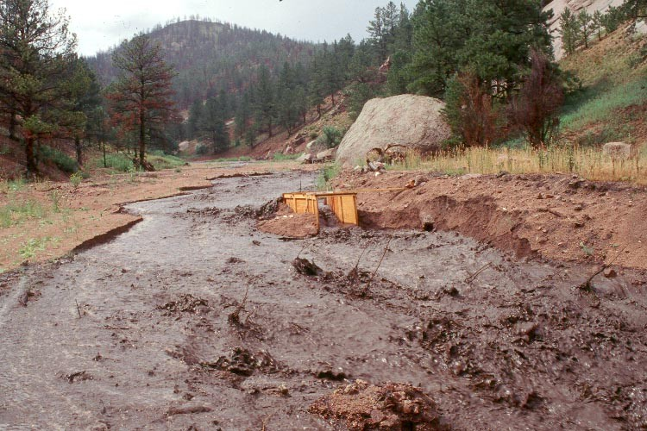
Mass Wasting and Flash Floods

Slide 2
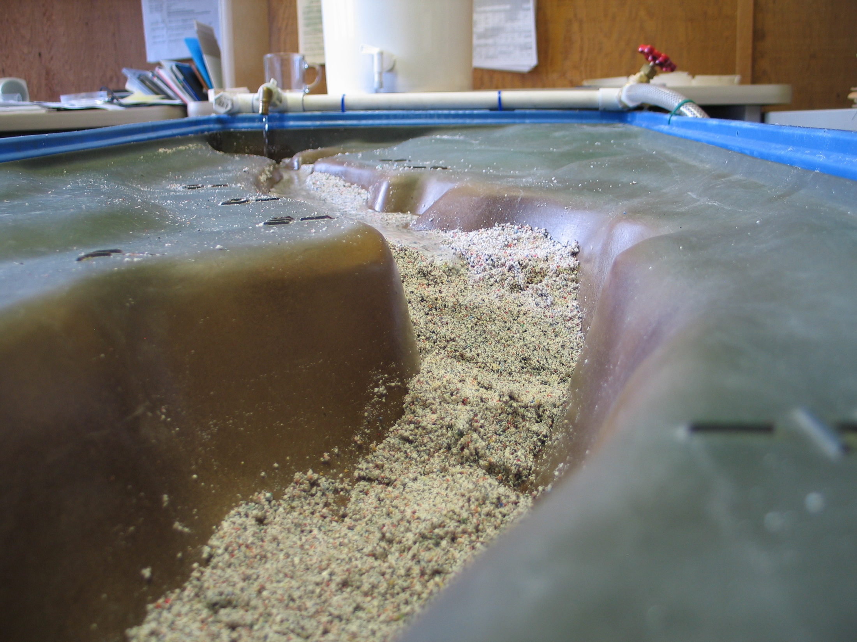
A Major Storm Upstream of this Dry Wash is Sending A Torrent Downstream

Slide 3

Most of the Initial Water is Soaking Into the Porous Sediment

Slide 4
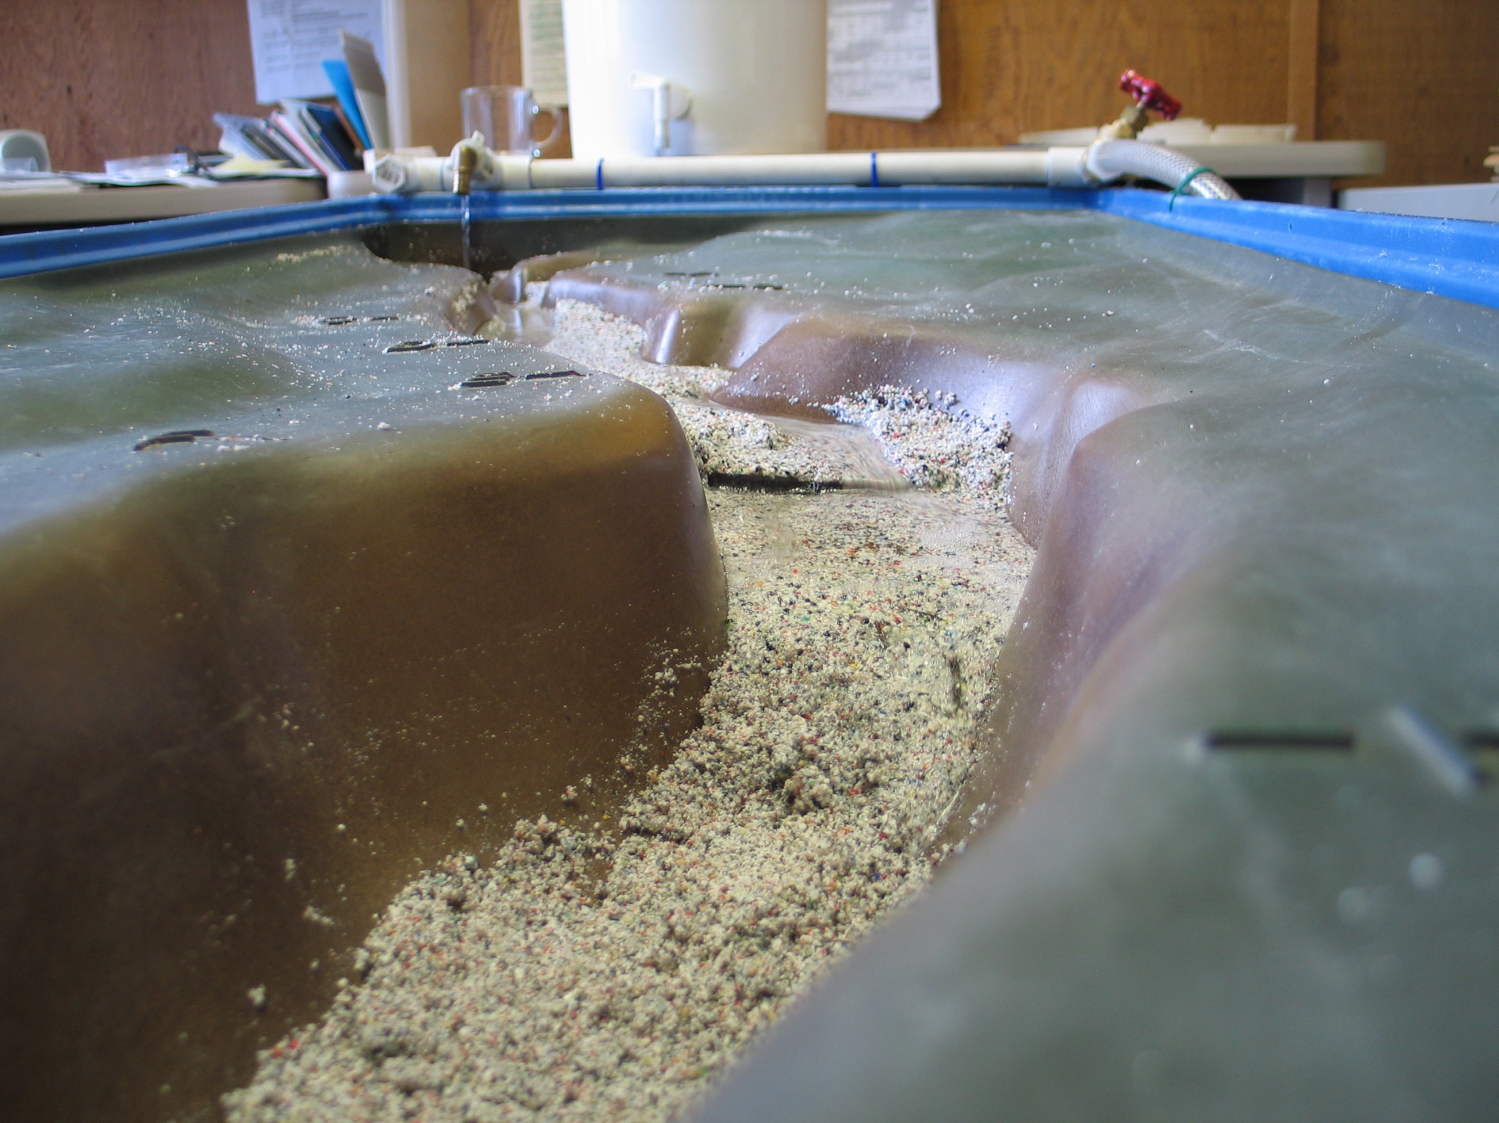
Supersaturated Sediments Are Beginning to Slump Under the Pressure of the Water

Slide 5
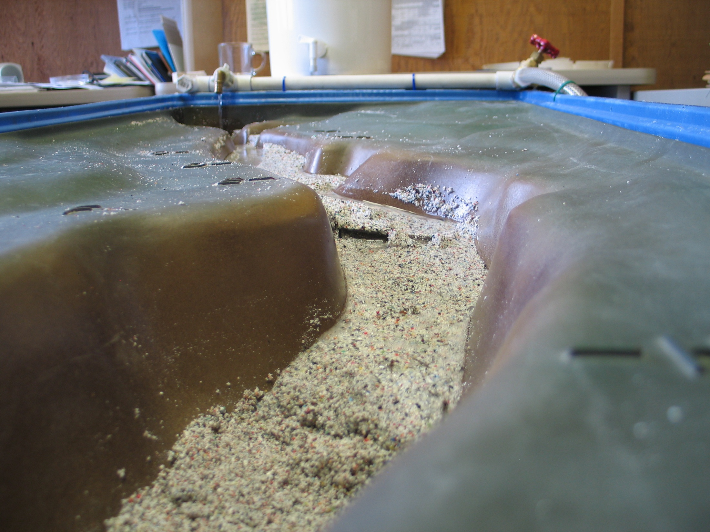
A Mass Wasting Event is Beginning, as the Entire Slope Moves Downstream

Slide 6
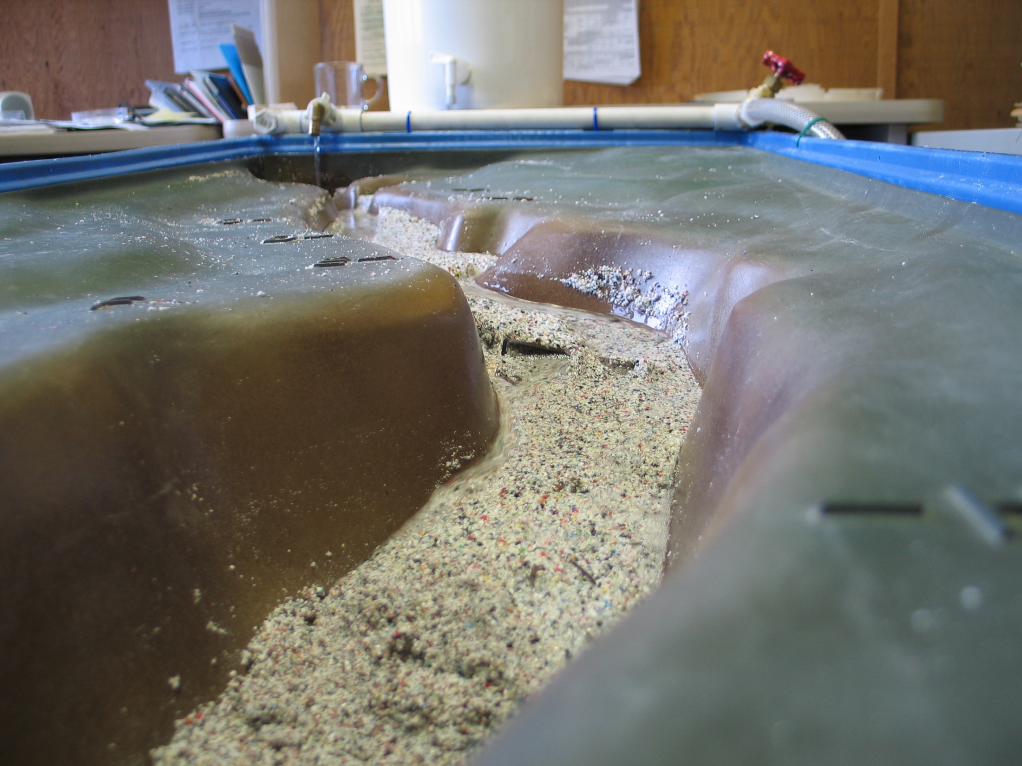
The Force of the Flash Flood Can Send Even Large Boulders Downstream!

Slide 7
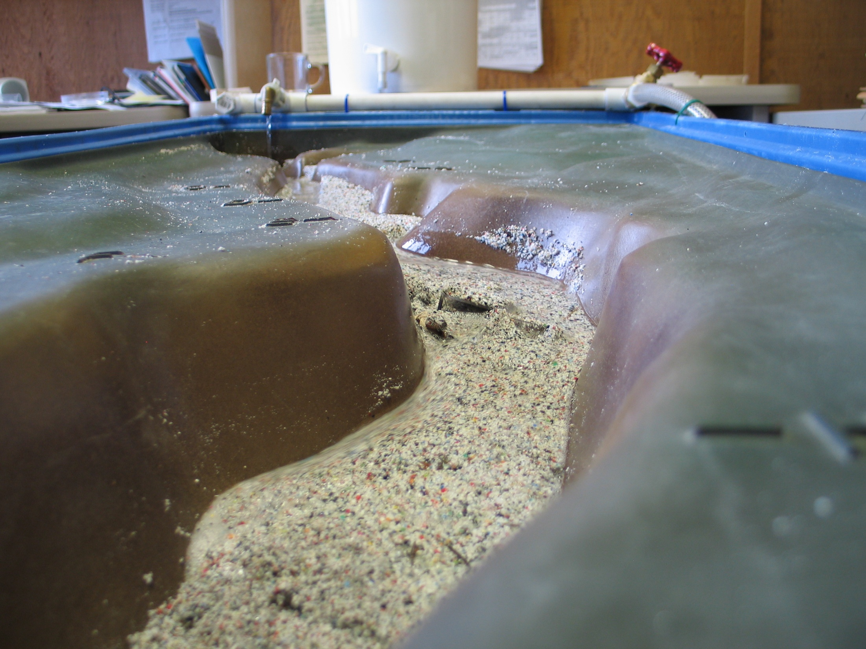

Slide 8
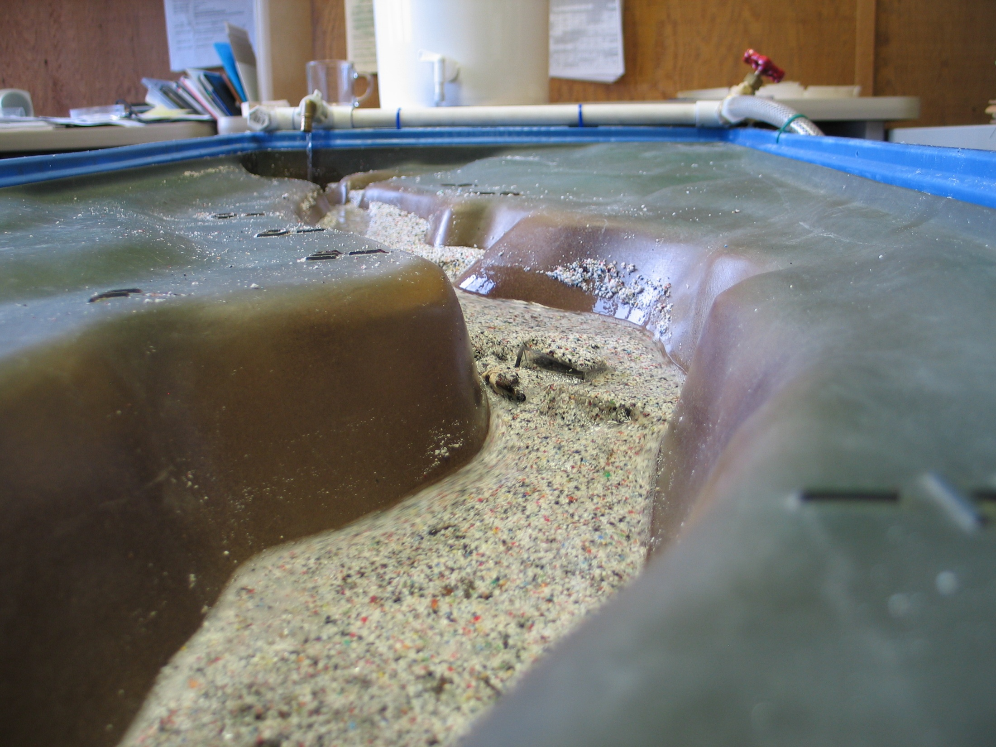

Slide 9
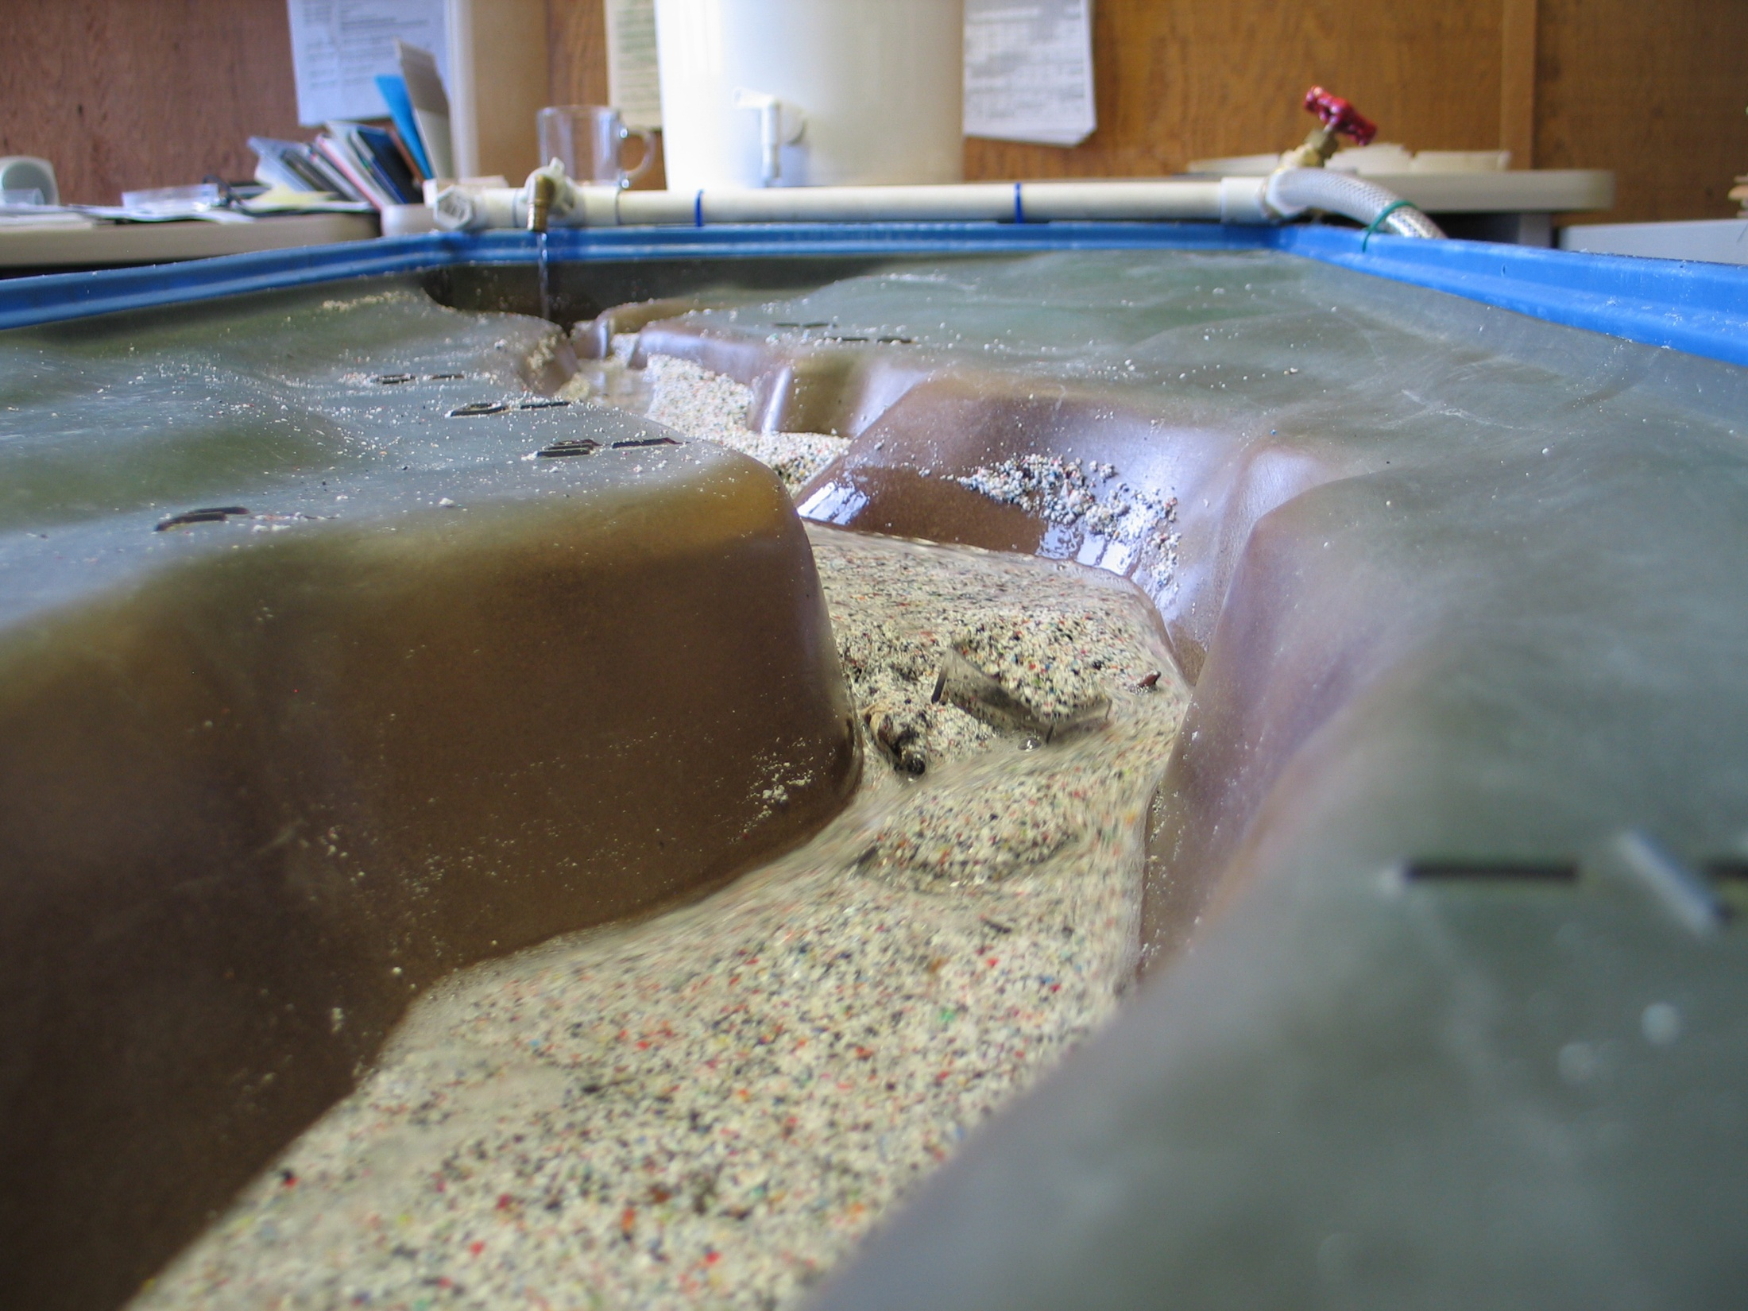
As the Gradient Levels Out, the River Starts to Eat Into the Sediment

Slide 10
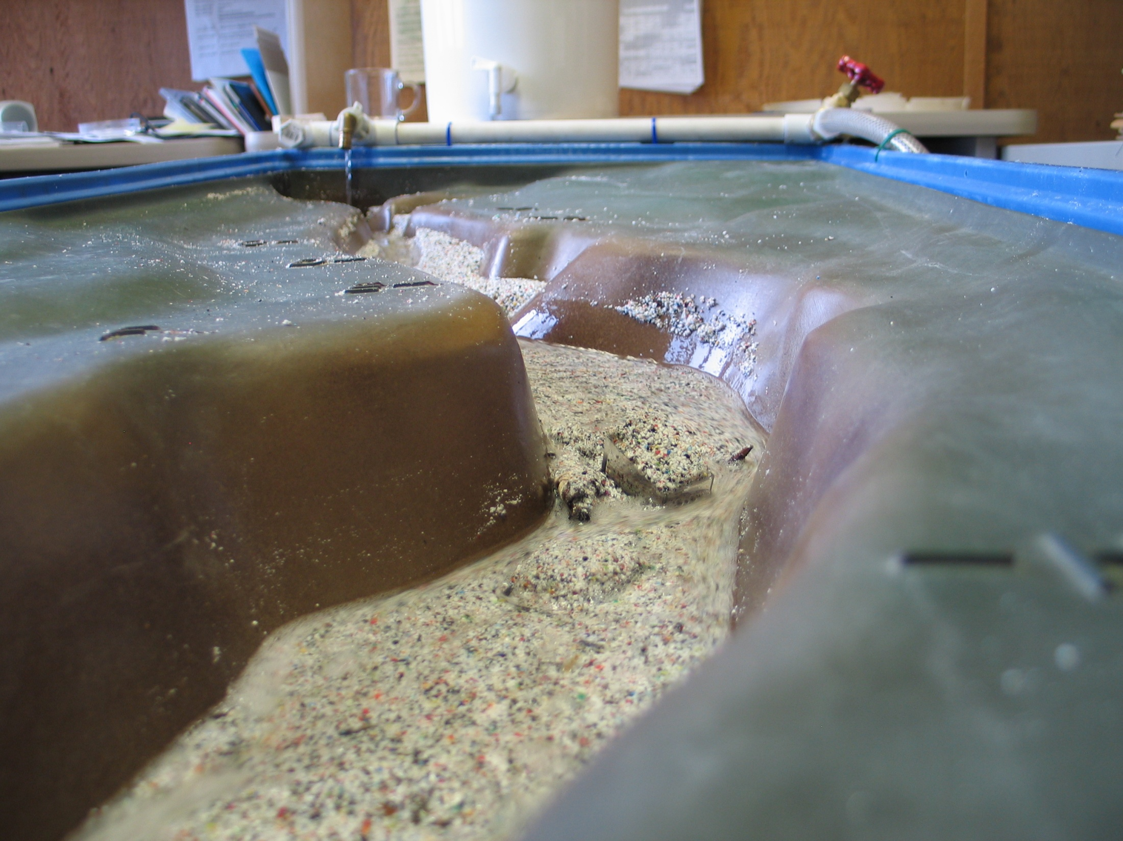

Slide 11


Slide 12
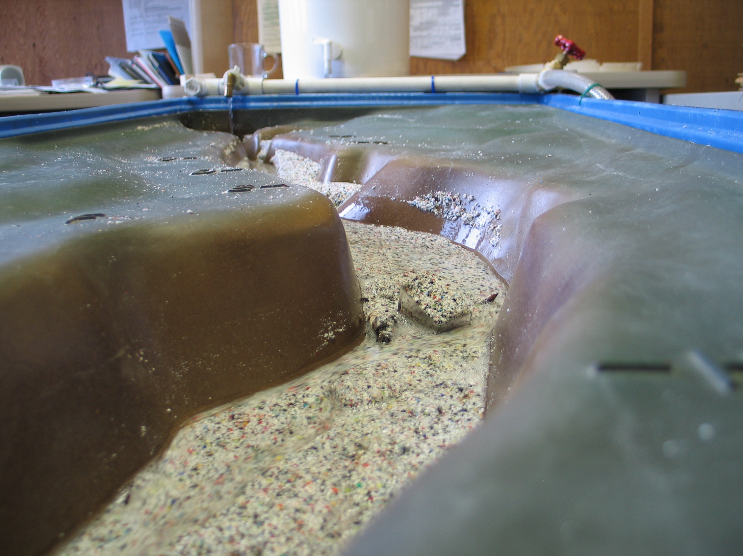

Slide 13
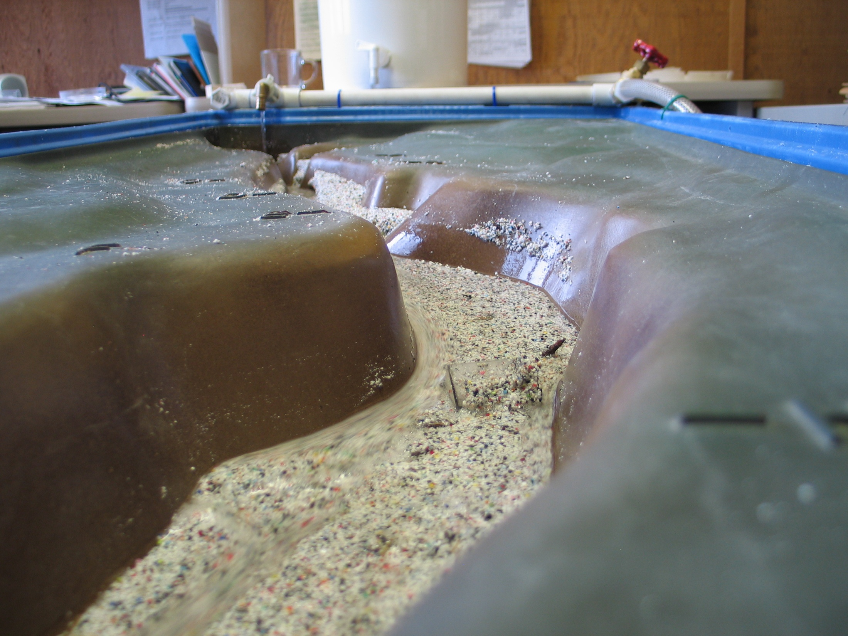

Slide 14
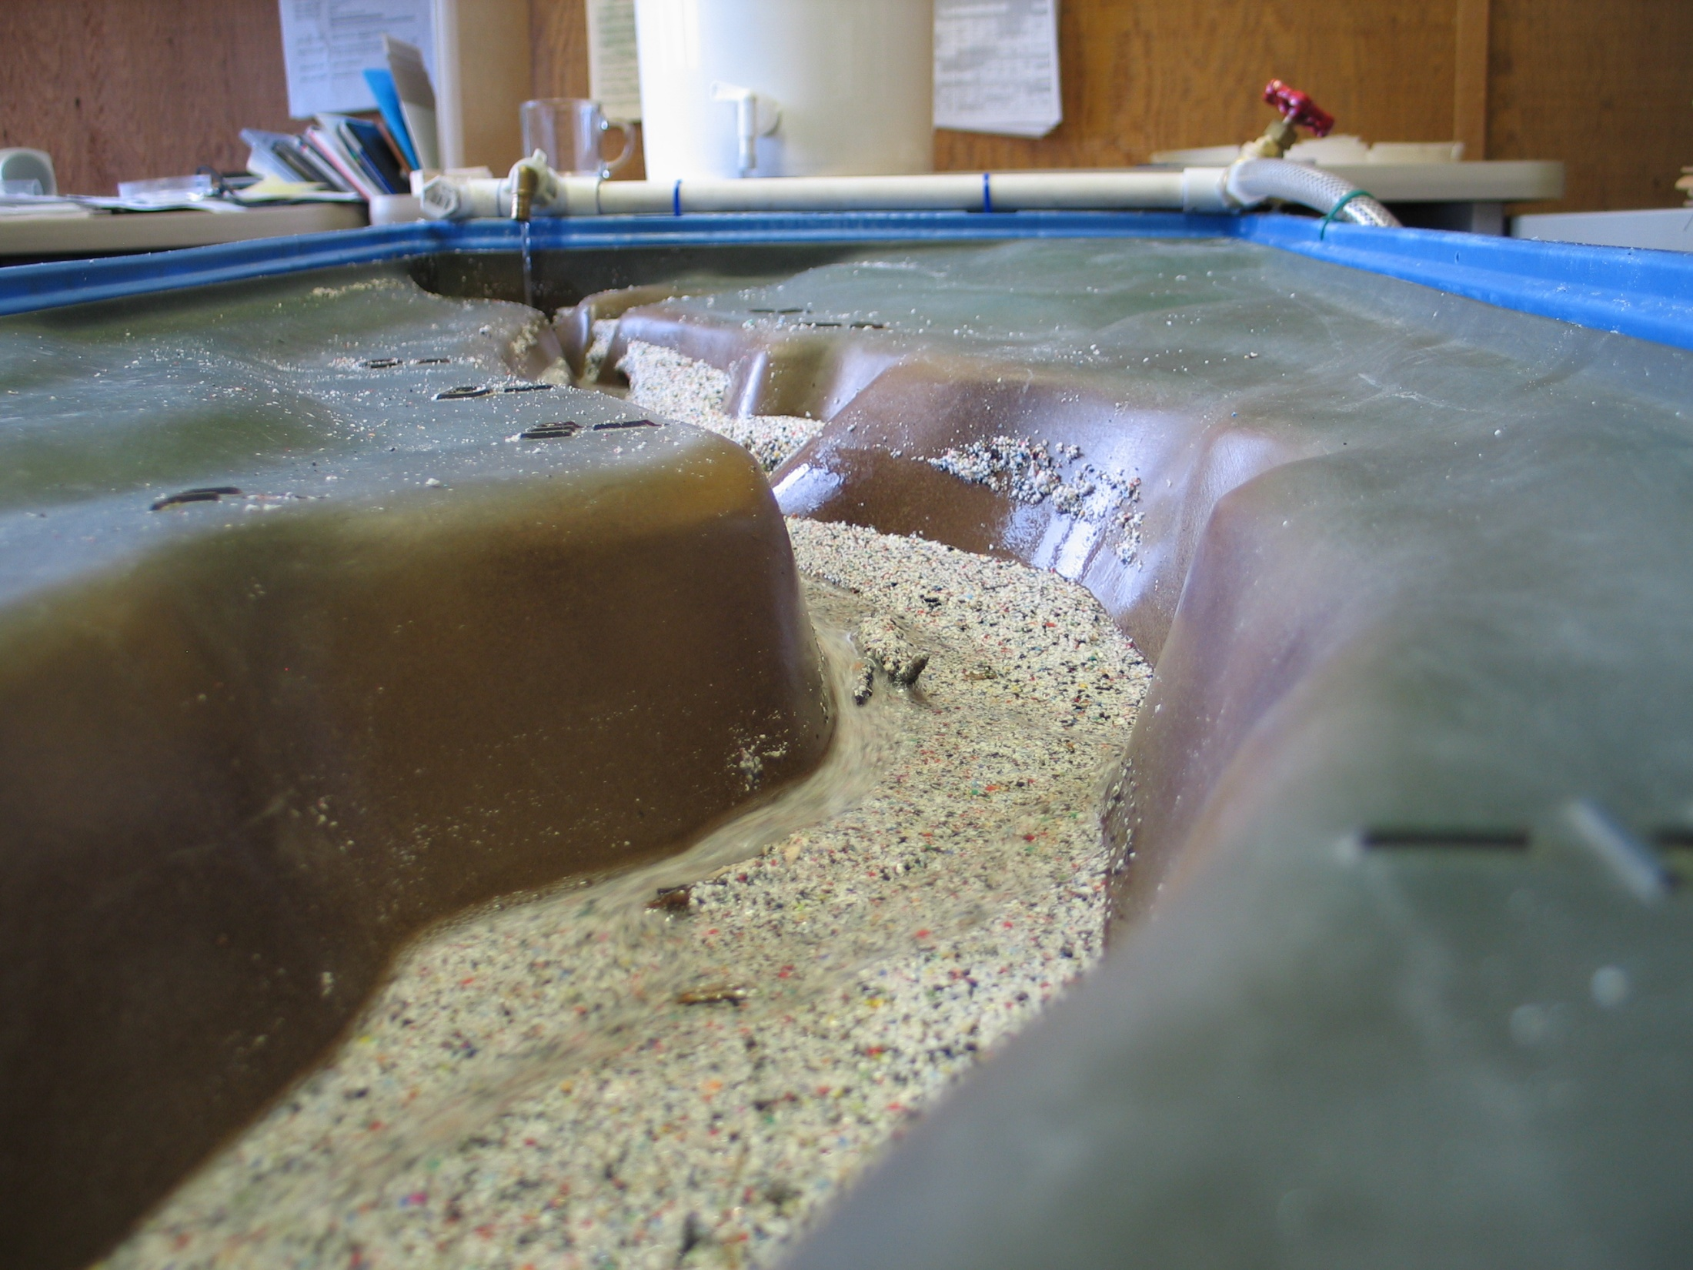
Hanging Benches Are Left Behind, As the River Cuts Deeper into the Sediment

Slide 15
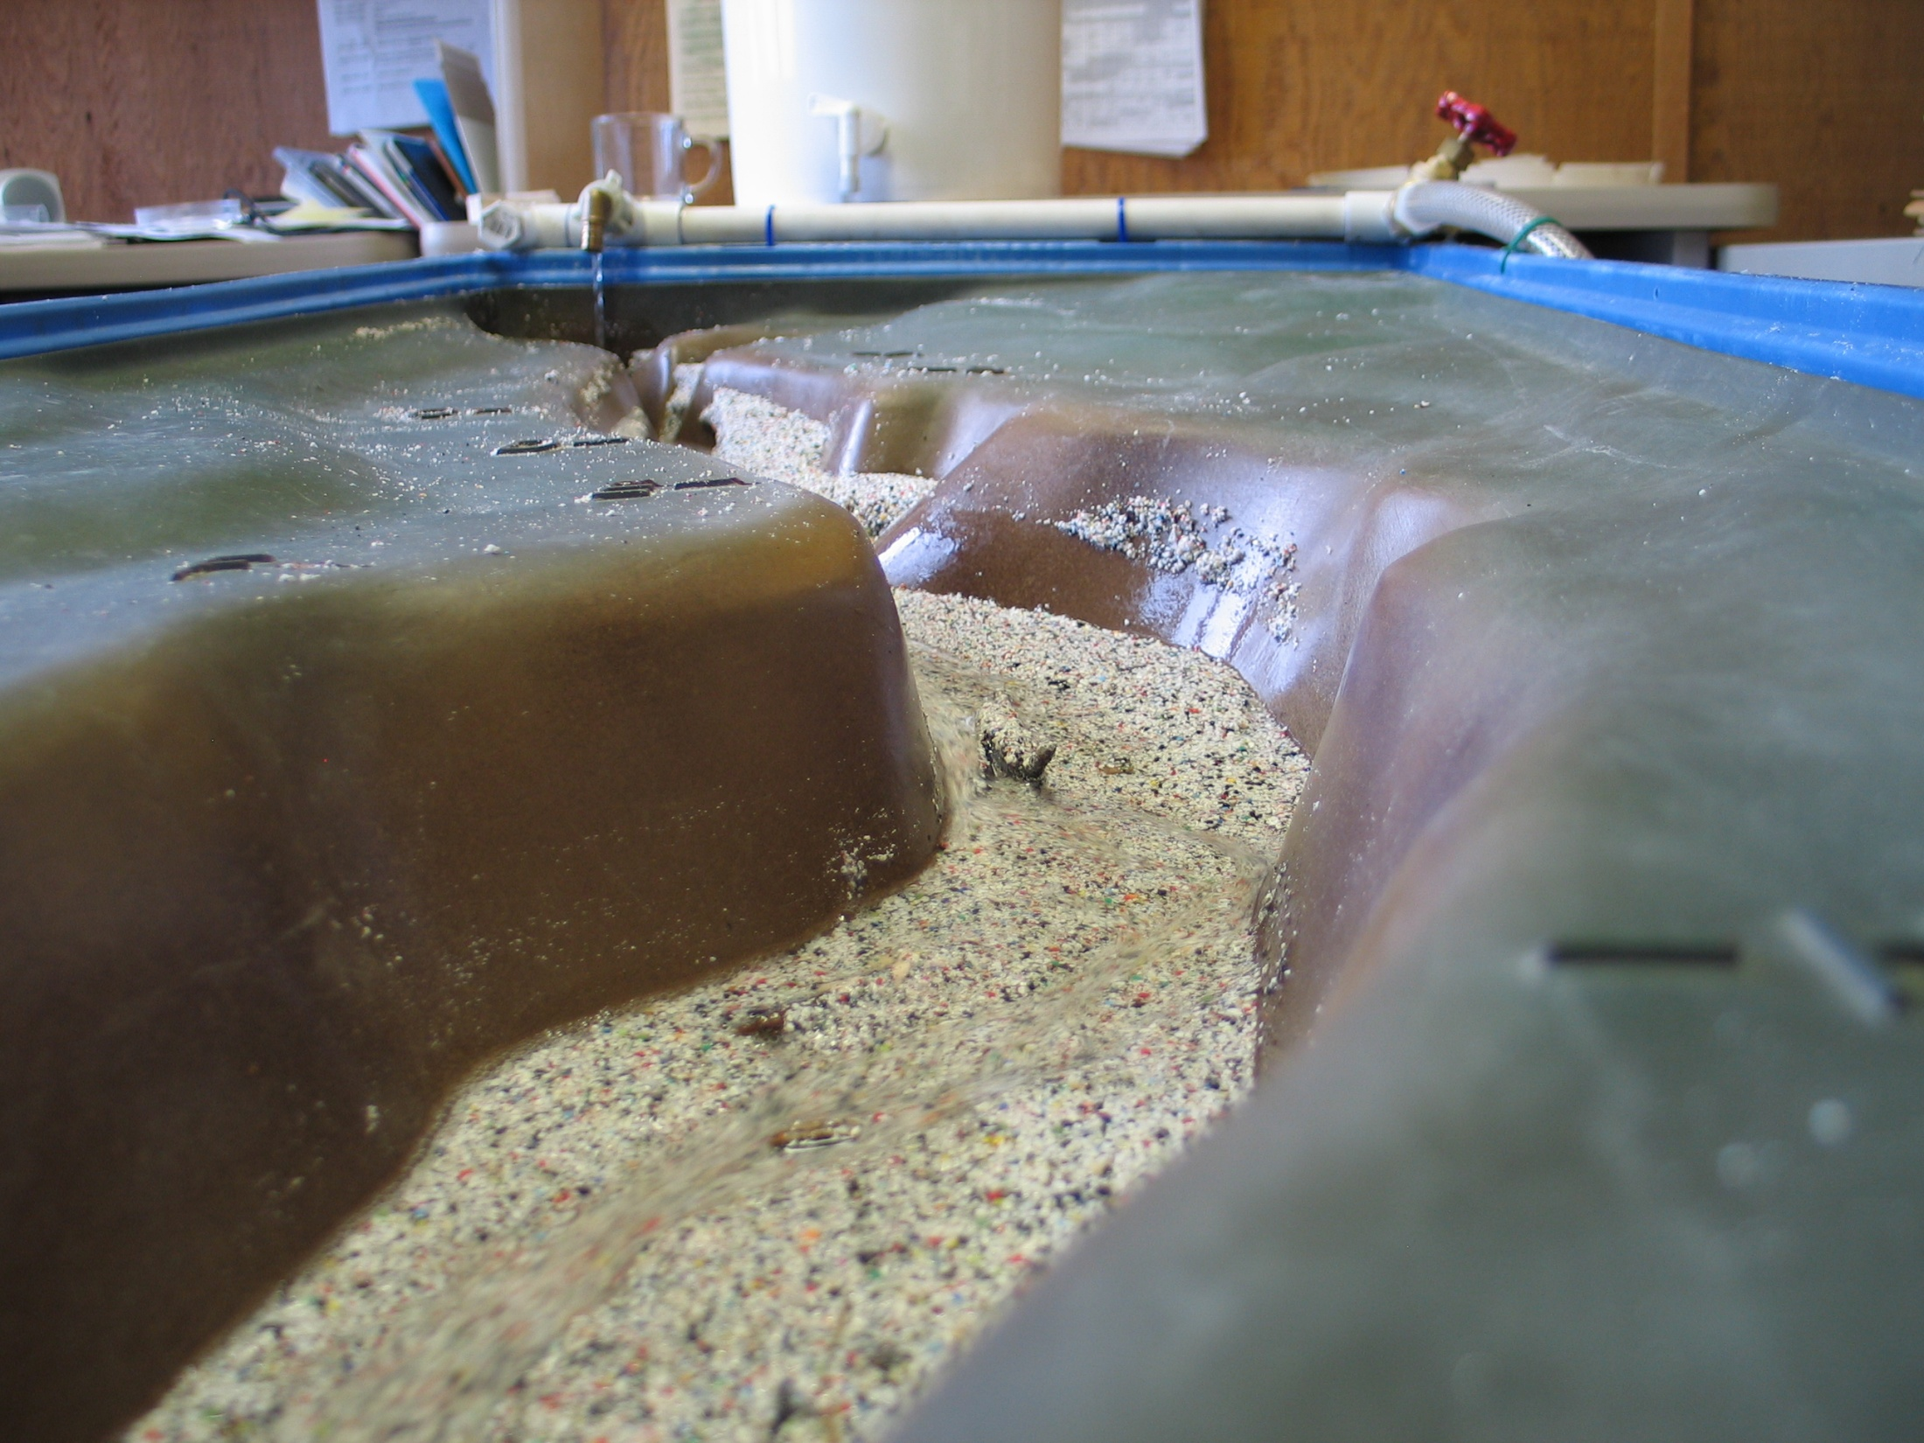

Slide 16


Slide 17
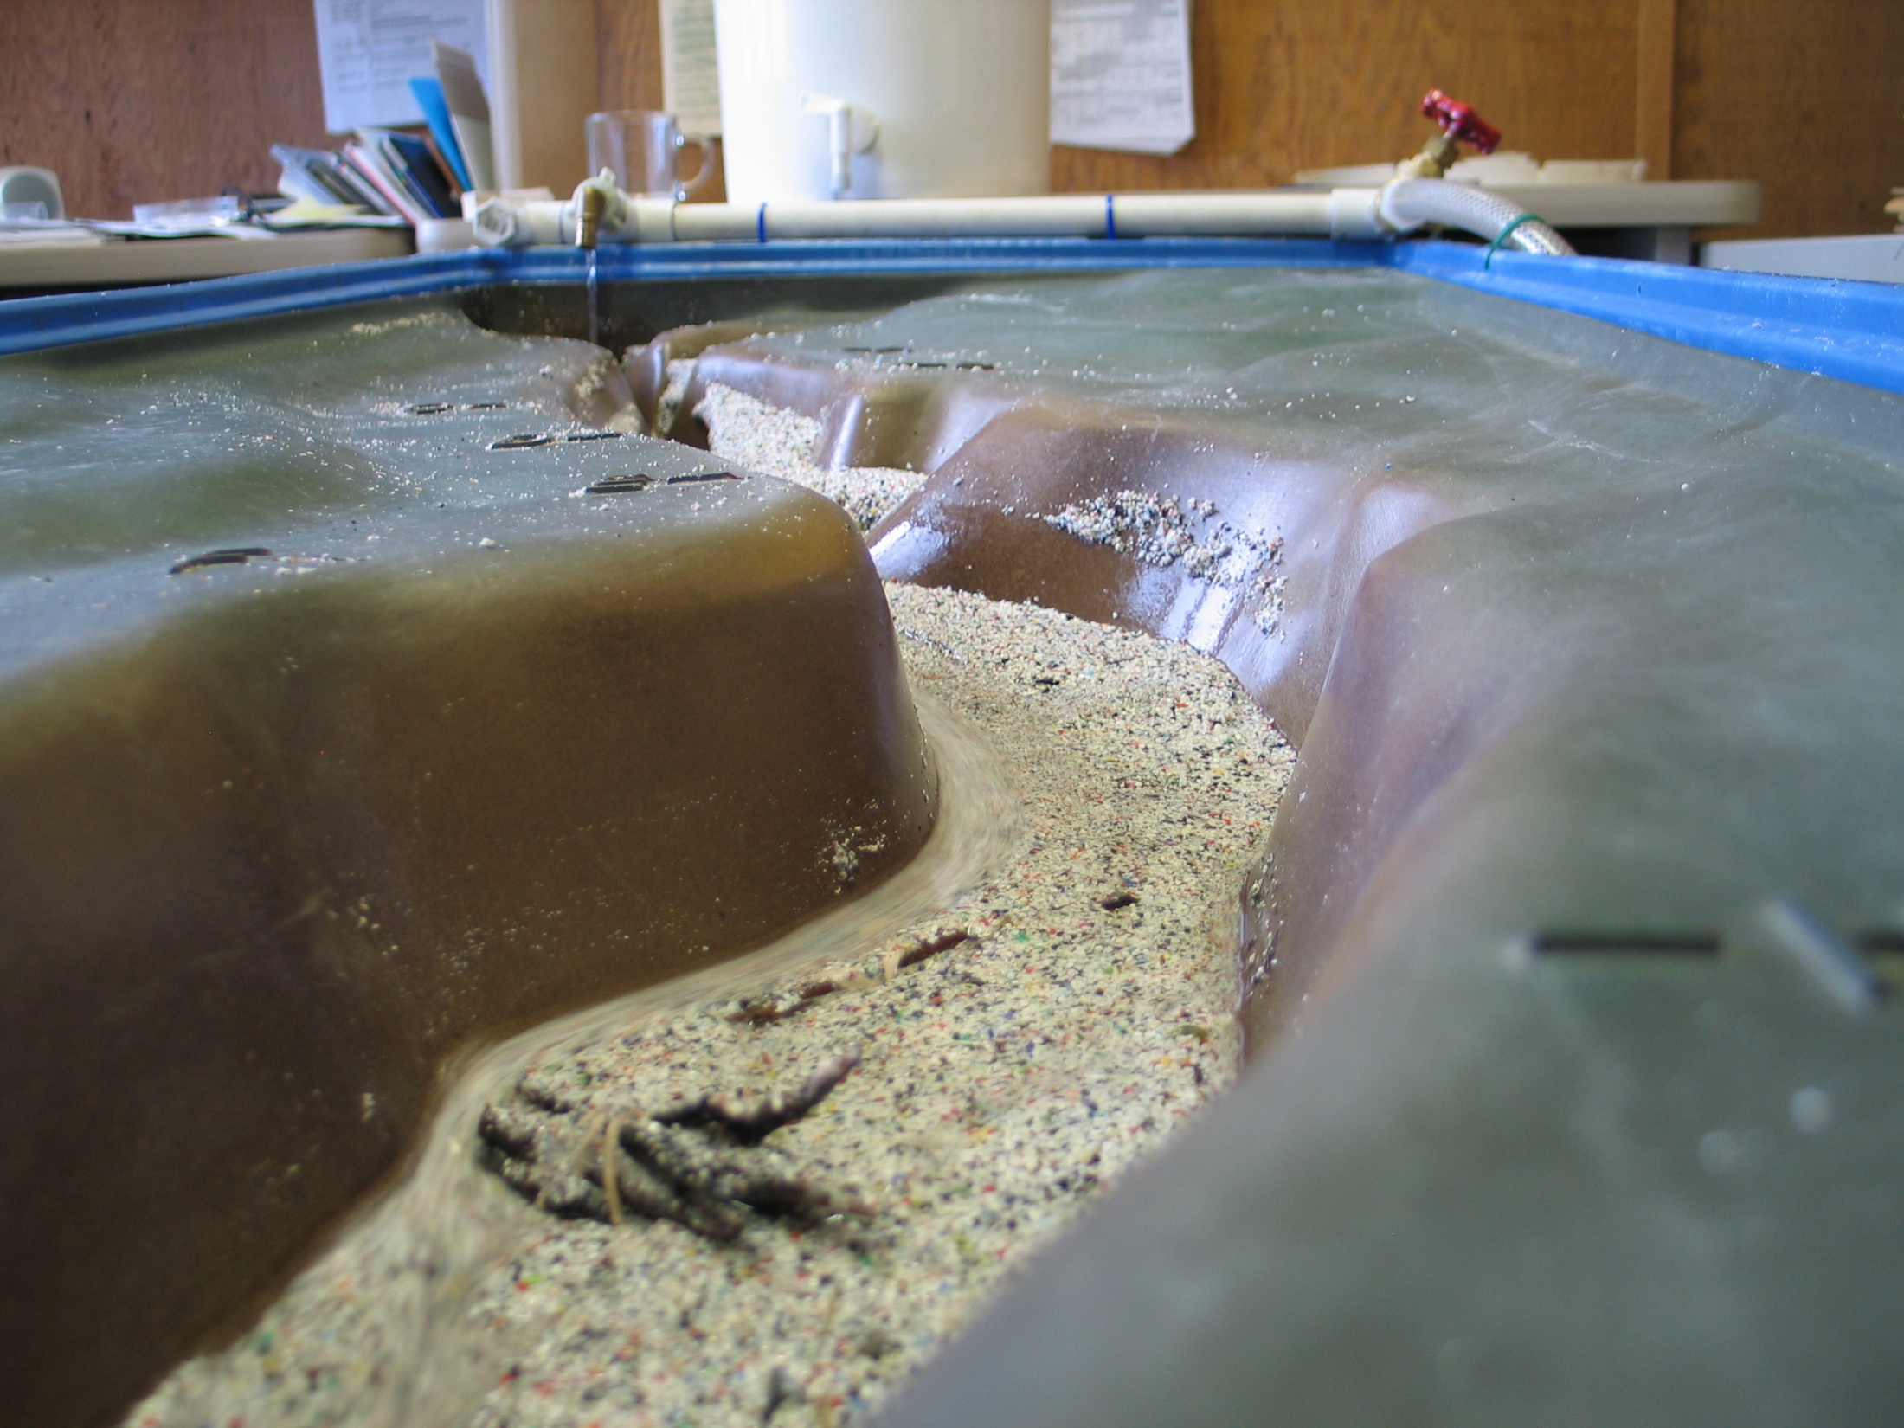

Slide 18
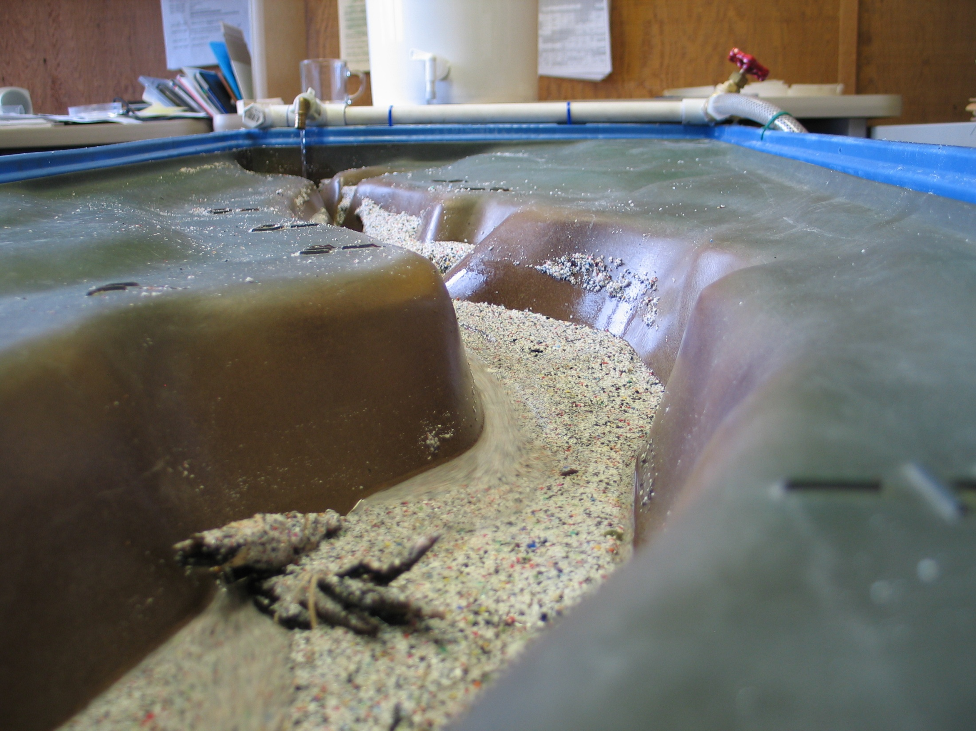
The Devastation is Nearly Complete

Slide 19

This project was made possible in part by a grant from
Washington’s National Park Fund.

